Slide 1
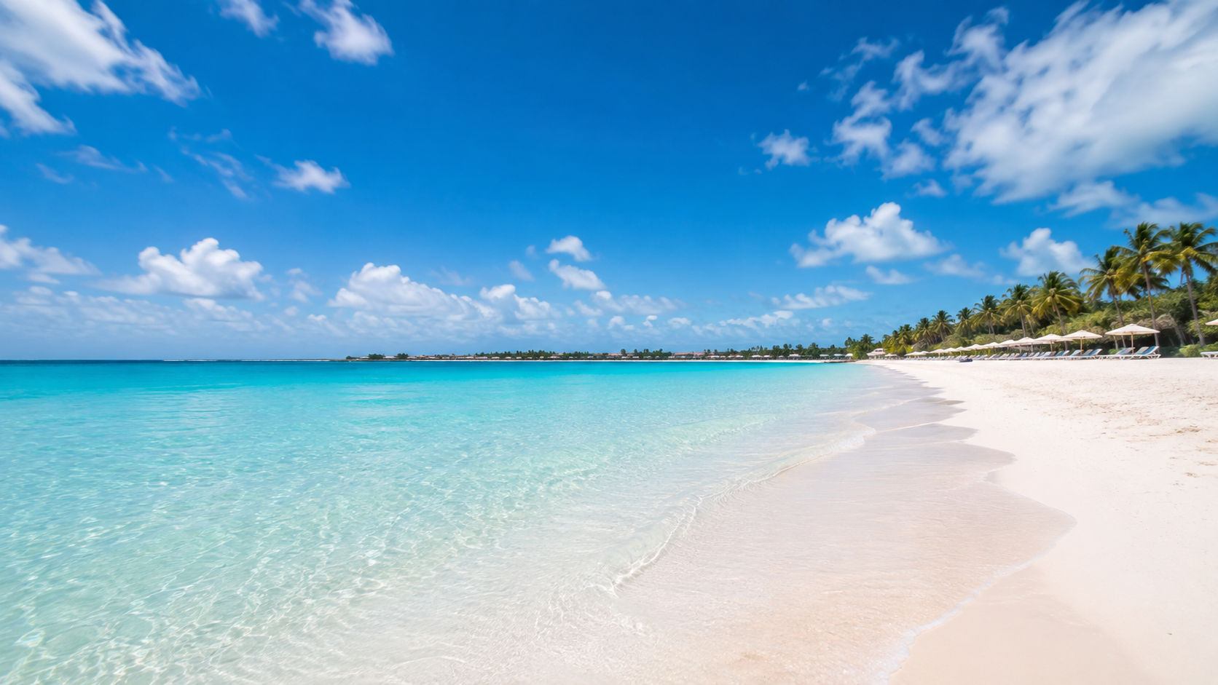
3 OPTIONS
A PRACTICAL SHORTLIST
Mediterranean island options
A concise shortlist for a 6-night summer escape

Slide 2
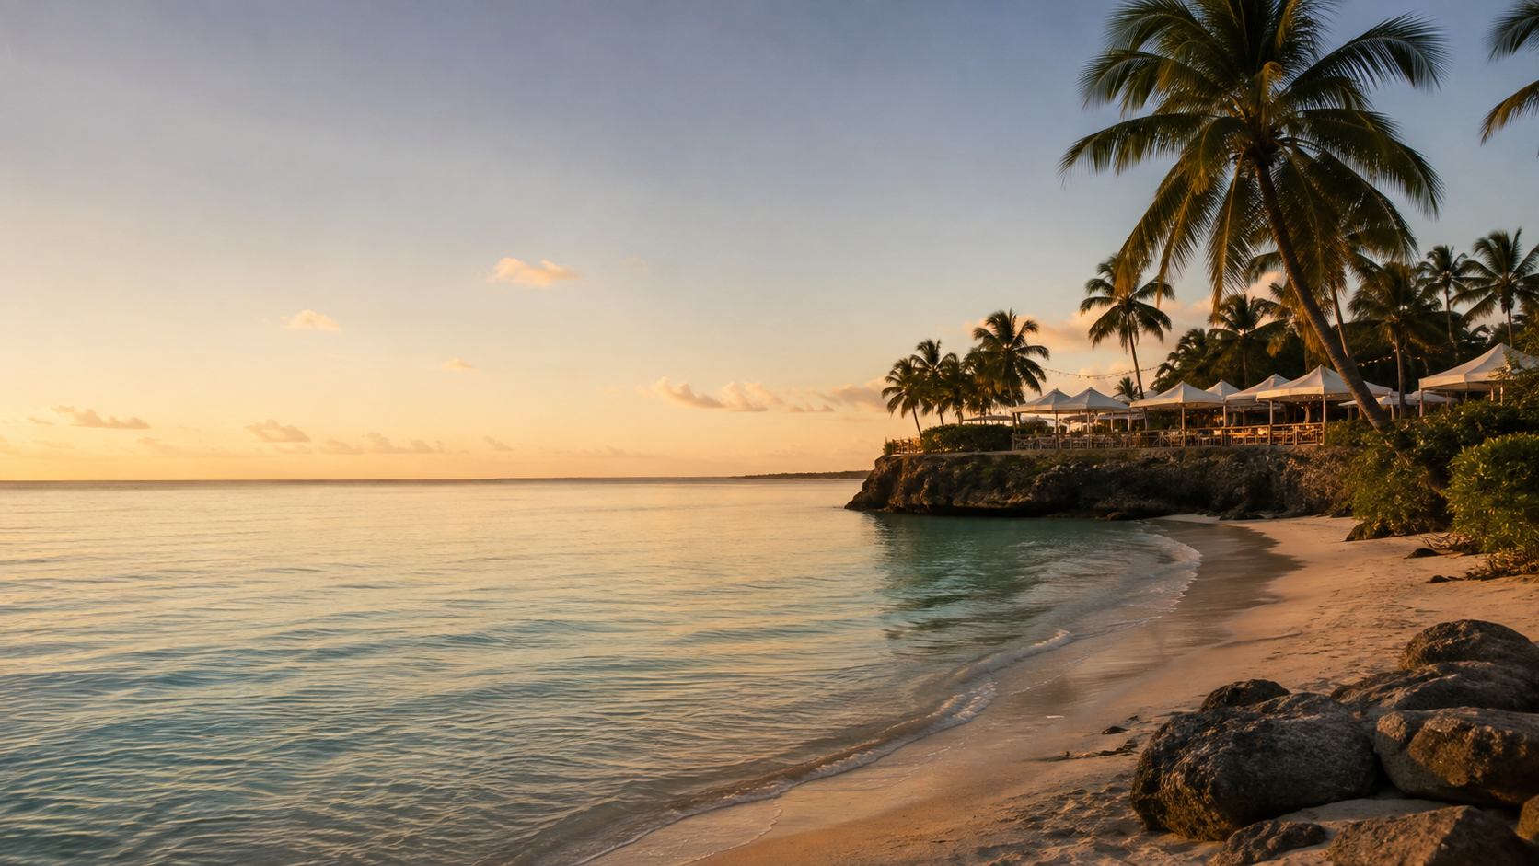
RECOMMENDATION
Mallorca is the balanced choice
Best overall for a 6-night trip: beaches, food, and low travel friction.
★★★★☆
4.5 / 5 WEIGHTED SCORE
£2.4–3.4k
4–6h

Slide 3
ILLUSTRATIVE PLANNING CASE
The planning case
6 nights • 2 adults • London-area departure June • £2.5k–3.5k target • not live quotes
Beach quality
Ease
Total cost
Experiences
Flexibility
30%
25%
20%
15%
10%

Slide 4
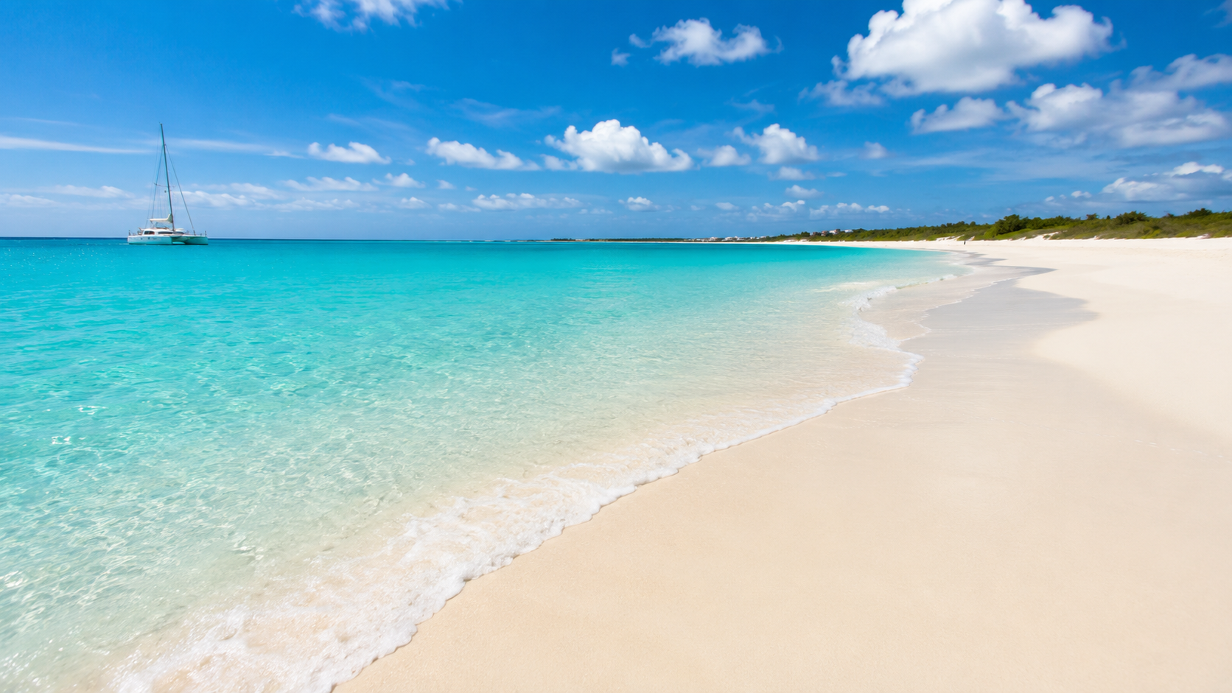
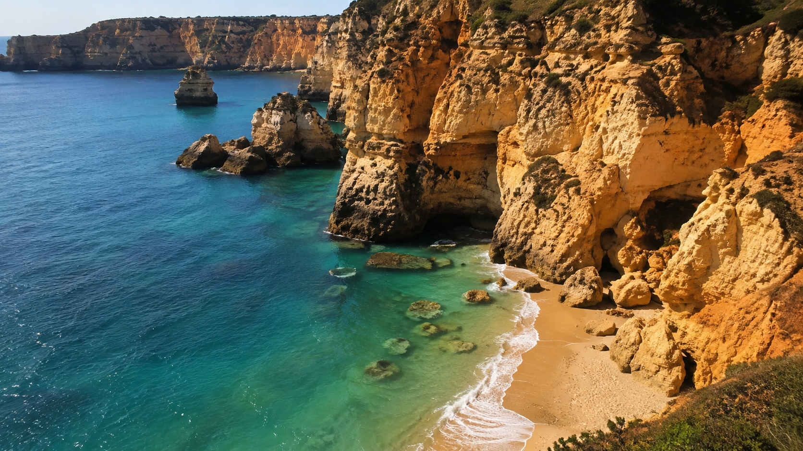

WEIGHTED SHORTLIST
Shortlist at a glance
Mallorca
Sardinia
Crete
★★★★☆
★★★★☆
★★★★☆
4.5 / 5
4.2 / 5
4.1 / 5
Balanced mix
Pure beach + scenery
Food + variety
£2.4–3.4k • 4–6h
£3.0–4.3k • 5–7h
£2.6–3.8k • 5–7h

Slide 5
OPTION 1 • BEST OVERALL
Mallorca
£2.4–3.4k total • 4–6h
Beach + food with the least friction.
★★★★☆
4.5 / 5 OVERALL
WHY IT WINS
Direct-flight choice with broad beach variety and Palma for dining/culture.
WATCH-OUTS
Peak summer crowds. A car helps if you want the quieter coves.

Slide 6
OPTION 2 • BEACH-FIRST SPLURGE
Sardinia
£3.0–4.3k total • 5–7h
The strongest beach scenery of the three.
★★★★☆
4.2 / 5 OVERALL
WHY IT WINS
Clear-water coves, dramatic coastline and excellent food.
WATCH-OUTS
Higher cost and more driving to reach the best beaches.

Slide 7
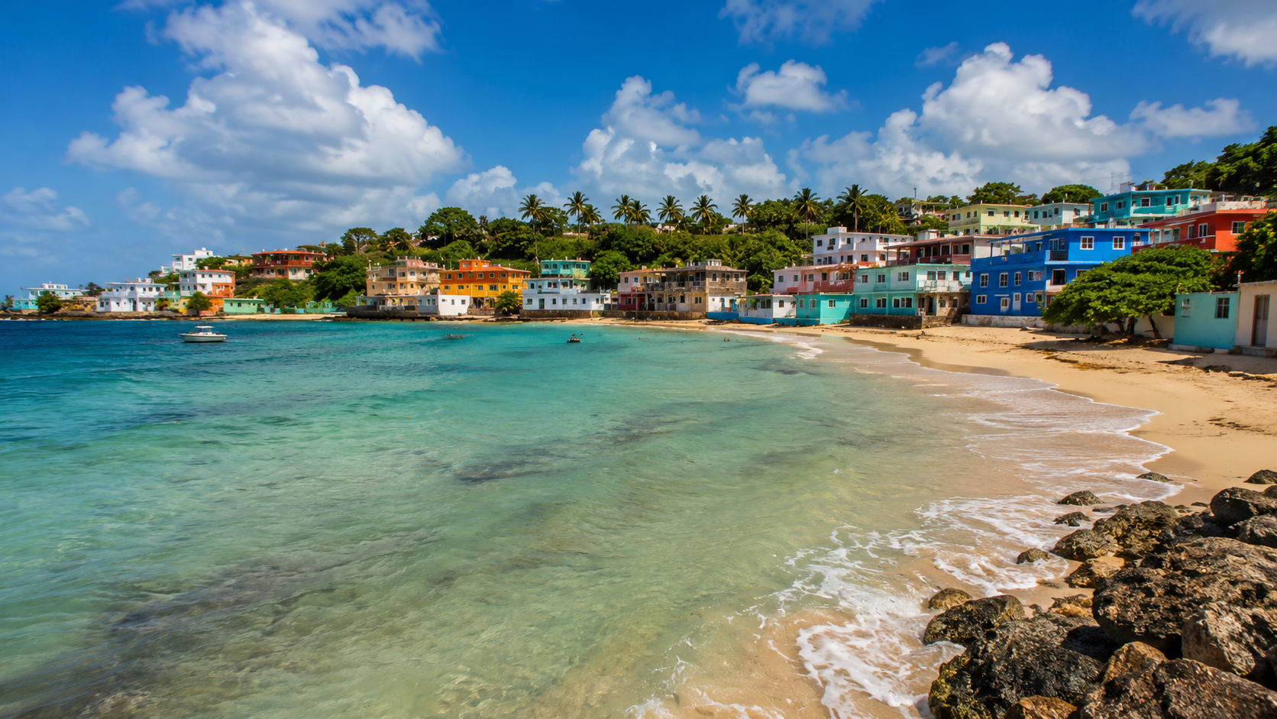
OPTION 3 • VARIETY VALUE PLAY
Crete
£2.6–3.8k total • 5–7h
Food, beaches and history in one trip.
★★★★☆
4.1 / 5 OVERALL
WHY IT WINS
Strong value with plenty to do beyond the shoreline.
WATCH-OUTS
Large island: transfers and day trips can become time-consuming.

Slide 8
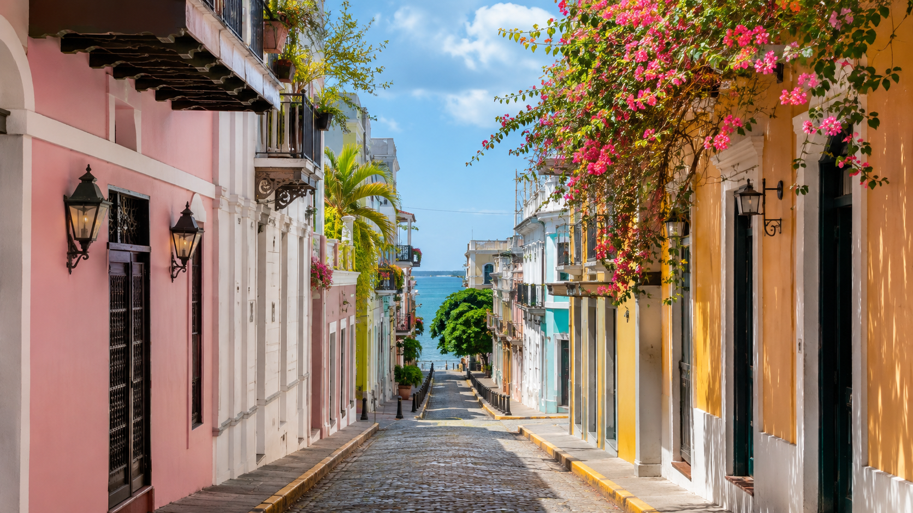
NEXT STEP
Book Mallorca if your priority is balance
1. Lock dates
Compare midweek departures and one flexible return.
2. Choose a base
Palma plus one beach-focused stay.
3. Price the bundle
Flights, lodging, transport and two paid activities.

